Slide 1
Module 9: The Transport Layer
Instructor Materials
CyberOps Associate v1.0
Notes:
Cisco Networking Academy Program
CyberOps Associate v1.0
Module 9: The Transport Layer

Slide 2
Instructor Materials – Module 9 Planning Guide
This PowerPoint deck is divided in two parts:
Instructor Planning Guide
Information to help you become familiar with the module
Teaching aids
Instructor Class Presentation
Optional slides that you can use in the classroom
Begins on slide # 8
Note: Remove the Planning Guide from this presentation before sharing with anyone.
For additional help and resources go to the Instructor Home Page and Course Resources for this course. You also can visit the professional development site on www.netacad.com, the official Cisco Networking Academy Facebook page, or Instructor Only FB group.
Notes:
2

Slide 3
What to Expect in this Module
To facilitate learning, the following features within the GUI may be included in this module:
Feature | Description
Animations | Expose learners to new skills and concepts.
Videos | Expose learners to new skills and concepts.
Check Your Understanding (CYU) | Per topic online quiz to help learners gauge content understanding.
Hands-On Labs | Labs designed for working with physical equipment.
Module Quizzes | Self-assessments that integrate concepts and skills learned throughout the series of topics presented in the module.
Module Summary | Briefly recaps module content.

Slide 4
Check Your Understanding
Check Your Understanding activities are designed to let students quickly determine if they understand the content and can proceed, or if they need to review.
Check Your Understanding activities do not affect student grades.
There are no separate slides for these activities in the PPT. They are listed in the notes area of the slide that appears before these activities.
Notes:
4

Slide 5
Module 9: Activities
What activities are associated with this module?
Page # | Activity Type | Activity Name | Optional?
9.1.11 | Check Your Understanding | Compare TCP and UDP Characteristics | Recommended
9.2.5 | Video | TCP 3-Way Handshake | Recommended
9.2.6 | Lab | Using Wireshark to Observe the TCP 3-Way Handshake | Recommended
9.2.7 | Check Your Understanding | TCP Connection and Termination Process | Recommended
9.3.2 | Video | TCP Reliability – Sequence Numbers and Acknowledgements | Recommended
9.3.4 | Video | TCP Reliability – Data Loss and Retransmission | Recommended
9.3.8 | Lab | Exploring Nmap | Recommended
9.3.9 | Check Your Understanding | Reliability and Flow Control | Recommended
Notes:
5

Slide 6
Module 9: Best Practices
Prior to teaching Module 9, the instructor should:
Review the activities and assessments for this module.
Try to include as many questions as possible to keep students engaged during classroom presentation.
Topic 9.1
Ask the class to share their understanding of the Transmission Control Protocol (TCP) and User Datagram Protocol (UDP) and then discuss the protocols with them.
Explain the transport layer responsibilities and protocols.
Describe the TCP and UDP headers and their fields. Ask the students to list out some basic differences between the two.
Define the socket pairs.
Notes:
6

Slide 7
Module 9: Best Practices (Contd.)
Topic 9.2
Explain the TCP server processes to the class.
Describe the processes of TCP connection establishment and session termination.
Ask the class what do they know of three-way handshake and then explain the TCP three-way handshake analysis to them.
Topic 9.3
Ask the class to mention some main features of TCP based on their knowledge.
Discuss the reliability and flow control features of TCP.
Notes:
7

Slide 8
Module 9: The Transport Layer
CyberOps Associate v1.0
Notes:
Cisco Networking Academy Program
CyberOps Associate v1.0
Module 9: The Transport Layer
In-Session Activities / Explanations:
Time: 5 min
Instructor Notes:
Welcome the audience in a warm and cordial manner. Ensure that everyone is set up with the required resources.
Introduce the topic and encourage learners to come up with a list of expectations from the session. Collate topics on the white board or Desktop while using learner’s inputs to interpret them in words.
To set the context of the module, ask the learners to share their understanding of transport layer and explain how TCP and UDP work in the transport layer.
Read out the Objectives and briefly describe each.
Key Points: NA

Slide 9
Module Objectives
Module Title: The Transport Layer
Module Objective: Explain how transport layer protocols support network functionality.
Topic Title | Topic Objective
Transport Layer Characteristics | Explain how transport layer protocols support network communication.
Transport Layer Session Establishment | Explain how the transport layer establishes communication sessions.
Transport Layer Reliability | Explain how the transport layer establishes reliable communications.
Notes:
9
CyberOps Associate v1.0
9 – The Transport Layer
9.0 – Introduction
9.0.2 – What Will I Learn in this Module?

Slide 10
9.1 Transport Layer Characteristics
Notes:
Source:
9 – The Transport Layer
9.1 – Transport Layer Characteristics
In-Session Activities / Explanations:
Time: 25 min
Instructor Notes:
Introduce the topic and discuss the transport layer.
Explain the transport layer responsibilities and protocols.
Ensure the learners have knowledge of Transmission Control Protocol (TCP) and its header.
Describe the User Datagram Protocol (UDP) and its header.
Ensure the learners have understanding of the socket pairs.
By the end of the topic, encourage the learners to complete the "Check Your Understanding – Compare TCP and UDP Characteristics".
Key Points: Transport Layer, TCP, TCP Header, UDP, UDP Header, Socket Pairs

Slide 11
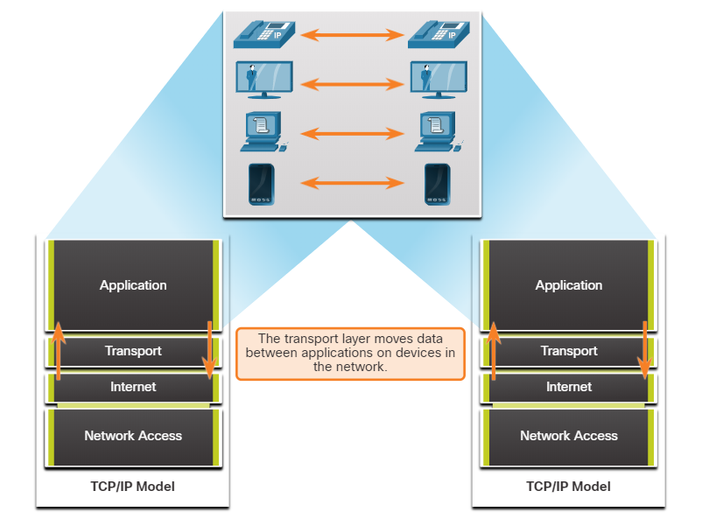
The Transport Layer Role of the Transport Layer
The transport layer is responsible for logical communications between applications running on different hosts.
As shown in the figure, the transport layer is the link between the application layer and the lower layers that are responsible for network transmission.
The transport layer has no knowledge of the destination host type, the type of media for which the data must travel, the path taken by the data, the congestion on a link, or the size of the network.
The transport layer includes two protocols, Transmission Control Protocol (TCP) and User Datagram Protocol (UDP).
Notes:
9 – The Transport Layer
9.1 – Transport Layer Characteristics
9.1.1 – Role of the Transport Layer

Slide 12
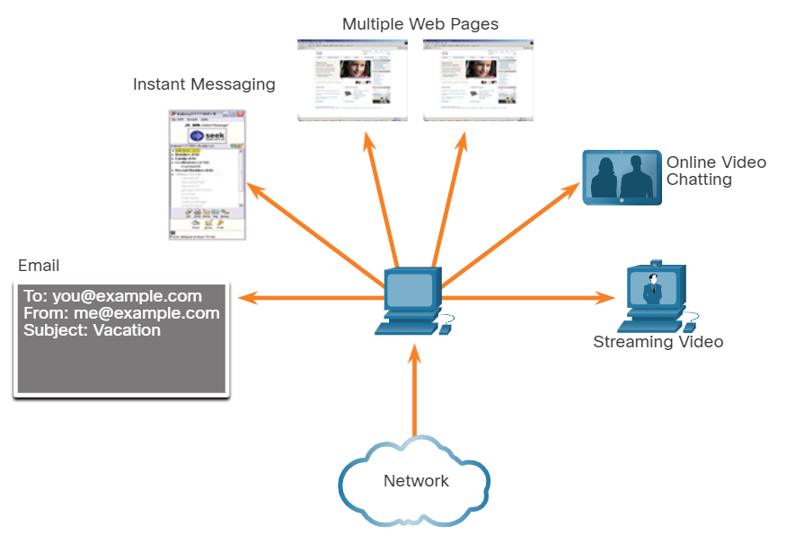
The Transport Layer Transport Layer Responsibilities
The transport layer has many responsibilities.
Tracking Individual Conversations
Each set of data flowing between a source application and a destination application is known as a conversation and is tracked separately.
It is the responsibility of the transport layer to maintain and track these multiple conversations.
As shown in the figure, a host may have multiple applications that are communicating across the network simultaneously.
Most networks have a limitation on the amount of data that can be included in a single packet. Data must be divided into manageable pieces.
Notes:
9 – The Transport Layer
9.1 – Transport Layer Characteristics
9.1.2 – Transport Layer Responsibilities

Slide 13
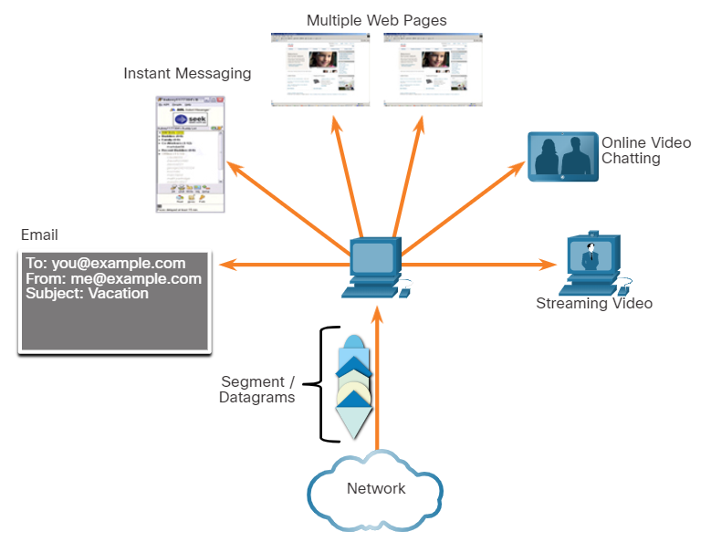
The Transport Layer Transport Layer Responsibilities (Contd.)
Segmenting Data and Reassembling Segments
It is the transport layer responsibility to divide the application data into appropriately sized blocks.
Depending on the transport layer protocol used, the transport layer blocks are called either segments or datagrams.
The figure shows the transport layer using different blocks for each conversation.
The transport layer divides the data into smaller blocks (segments or datagrams) that are easier to manage and transport.
Notes:
9 – The Transport Layer
9.1 – Transport Layer Characteristics
9.1.2 – Transport Layer Responsibilities

Slide 14
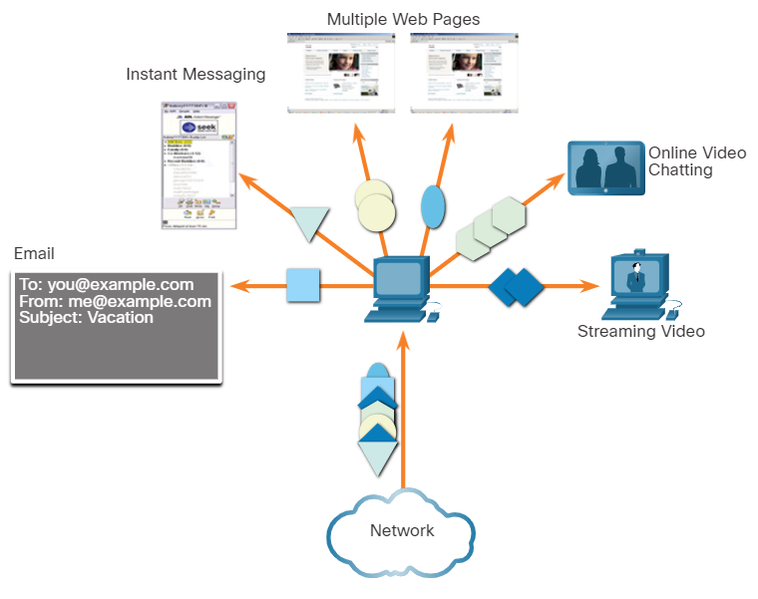
The Transport Layer Transport Layer Responsibilities (Contd.)
Add Header Information
The transport layer protocol also adds header information containing binary data organized into several fields to each block of data.
The values in these fields enable various transport layer protocols to perform different functions in managing data communication.
The header information is used by the receiving host to reassemble the blocks of data into a complete data stream for the receiving application layer program.
The transport layer ensures that even with multiple application running on a device, all applications receive the correct data.
Notes:
9 – The Transport Layer
9.1 – Transport Layer Characteristics
9.1.2 – Transport Layer Responsibilities

Slide 15
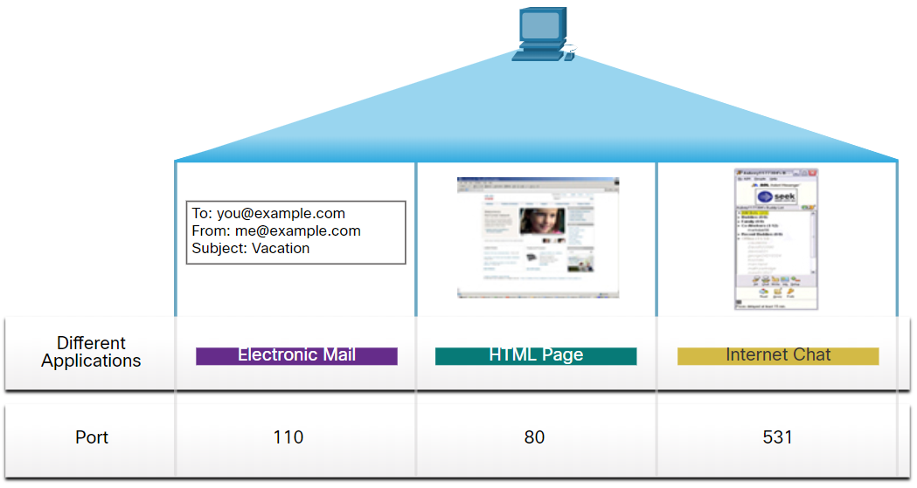
The Transport Layer Transport Layer Responsibilities (Contd.)
Identifying the Applications
The transport layer must be able to separate and manage multiple communications with different transport requirement needs.
To pass data streams to the proper applications, the transport layer identifies the target application using an identifier called a port number.
As shown in the figure, each software process that needs to access the network is assigned a port number unique to that host.
Notes:
9 – The Transport Layer
9.1 – Transport Layer Characteristics
9.1.2 – Transport Layer Responsibilities

Slide 16
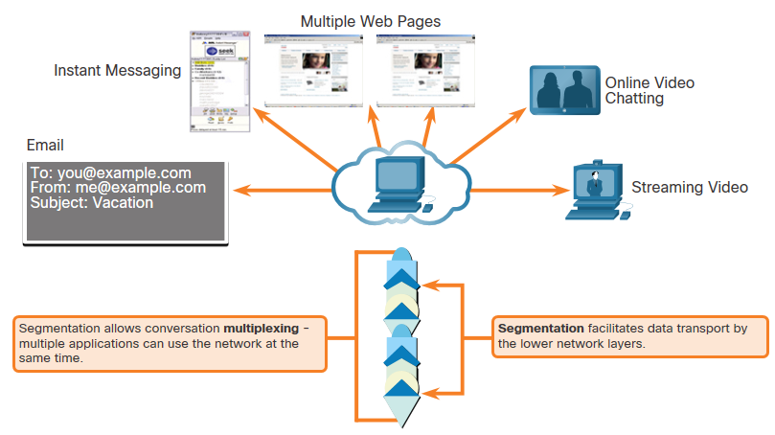
The Transport Layer Transport Layer Responsibilities (Contd.)
Conversation Multiplexing
Sending some types of data across a network, as one complete communication stream, can consume all the available bandwidth.
This prevents other communication conversations from occurring at the same time and also make error recovery and retransmission of damaged data difficult.
As shown in the figure, the transport layer uses segmentation and multiplexing to enable different communication conversations to be interleaved on the same network.
Error checking can be performed on the data in the segment, to determine if the segment was altered during transmission.
Notes:
9 – The Transport Layer
9.1 – Transport Layer Characteristics
9.1.2 – Transport Layer Responsibilities

Slide 17
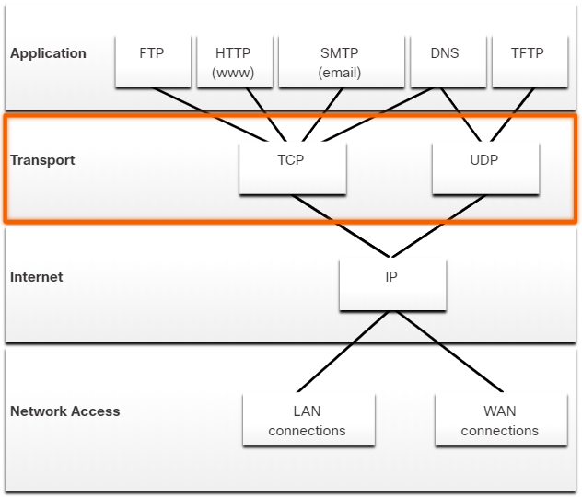
The Transport Layer Transport Layer Protocols
IP is concerned only with the structure, addressing, and routing of packets.
IP does not specify how the delivery or transportation of the packets takes place.
Transport layer protocols (TCP and UDP) specify how to transfer messages between hosts, and are responsible for managing reliability requirements of a conversation.
The transport layer includes the TCP and UDP protocols.
Different applications have different transport reliability requirements. Therefore, TCP/IP provides two transport layer protocols, as shown in the figure.
Notes:
9 – The Transport Layer
9.1 – Transport Layer Characteristics
9.1.3 – Transport Layer Protocols

Slide 18
The Transport Layer Transmission Control Protocol (TCP)
TCP is considered a reliable, full-featured transport layer protocol, which ensures that all of the data arrives at the destination.
TCP includes fields which ensure the delivery of the application data. These fields require additional processing by the sending and receiving hosts.
TCP transport is analogous to sending packages that are tracked from source to destination.
TCP provides reliability and flow control using these basic operations:
Number and track data segments transmitted to a specific host from a specific application
Acknowledge received data
Retransmit any unacknowledged data after a certain amount of time
Sequence data that might arrive in wrong order
Send data at an efficient rate that is acceptable by the receiver
Note: TCP divides data into segments.
Notes:
9 – The Transport Layer
9.1 – Transport Layer Characteristics
9.1.4 – Transmission Control Protocol (TCP)

Slide 19
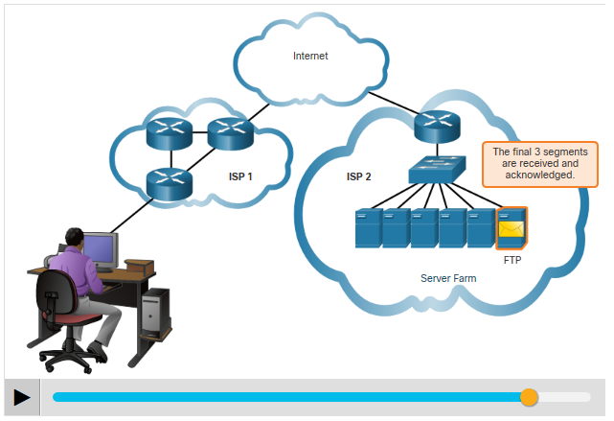
The Transport Layer Transmission Control Protocol (TCP) (Contd.)
In order to maintain the state of a conversation and track the information, TCP must first establish a connection between the sender and the receiver. This is why TCP is known as a connection-oriented protocol.
Notes:
9 – The Transport Layer
9.1 – Transport Layer Characteristics
9.1.4 – Transmission Control Protocol (TCP)

Slide 20
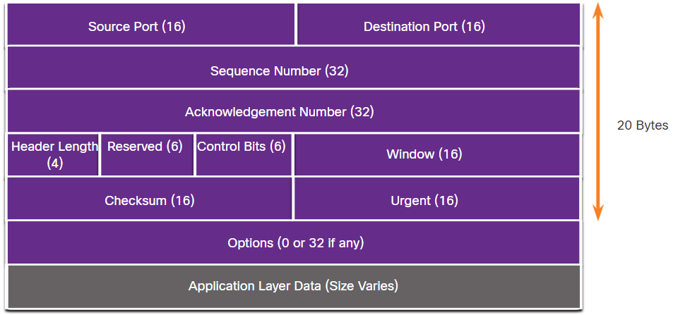
The Transport Layer TCP Header
TCP is a stateful protocol as it keeps track of the state of the communication session.
To track the state of a session, TCP records which information it has sent and which information has been acknowledged.
The stateful session begins with the session establishment and ends with the session termination.
A TCP segment adds 20 bytes (160 bits) of overhead when encapsulating the application layer data. The figure shows the fields in a TCP header.
Notes:
9 – The Transport Layer
9.1 – Transport Layer Characteristics
9.1.5 – TCP Header

Slide 21
The Transport Layer TCP Header Fields
The table identifies and describes the ten fields in a TCP header.
TCP Header Field | Description
Source Port | A 16-bit field used to identify the source application by port number.
Destination Port | A 16-bit field used to identify the destination application by port number.
Sequence Number | A 32-bit field used for data reassembly purposes.
Acknowledgment Number | A 32-bit field used to indicate that data has been received and the next byte expected from the source.
Header Length | A 4-bit field known as ʺdata offsetʺ that indicates the length of the TCP segment header.
Reserved | A 6-bit field that is reserved for future use.
Control bits | A 6-bit field that includes bit codes, or flags, which indicate the purpose and function of the TCP segment.
Window size | A 16-bit field used to indicate the number of bytes that can be accepted at one time.
Checksum | A 16-bit field used for error checking of the segment header and data.
Urgent | A 16-bit field used to indicate if the contained data is urgent.
Notes:
9 – The Transport Layer
9.1 – Transport Layer Characteristics
9.1.6 – TCP Header Fields

Slide 22
The Transport Layer User Datagram Protocol (UDP)
UDP is a simpler transport layer protocol than TCP.
It does not provide reliability and flow control, which means it requires fewer header fields.
The sender and the receiver UDP processes do not have to manage reliability and flow control, this means UDP datagrams can be processed faster than TCP segments.
UDP provides the basic functions for delivering datagrams between the appropriate applications, with very little overhead and data checking.
UDP is a connectionless protocol. Because UDP does not provide reliability or flow control, it does not require an established connection.
UDP is also known as a stateless protocol. Because UDP does not track information sent or received between the client and server.
Note: UDP divides data into datagrams that are also referred to as segments.
Notes:
9 – The Transport Layer
9.1 – Transport Layer Characteristics
9.1.7 – User Datagram Protocol (UDP)

Slide 23
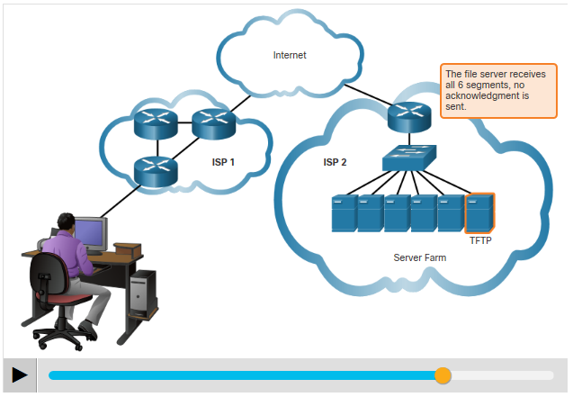
The Transport Layer User Datagram Protocol (UDP) (Contd.)
UDP is also known as a best-effort delivery protocol because there is no acknowledgment that the data is received at the destination.
UDP is like placing a regular, nonregistered, letter in the mail. The sender of the letter is not aware of the availability of the receiver to receive the letter. Nor is the post office responsible for tracking the letter or informing the sender if the letter does not arrive at the final destination.
Notes:
9 – The Transport Layer
9.1 – Transport Layer Characteristics
9.1.7 – User Datagram Protocol (UDP)

Slide 24
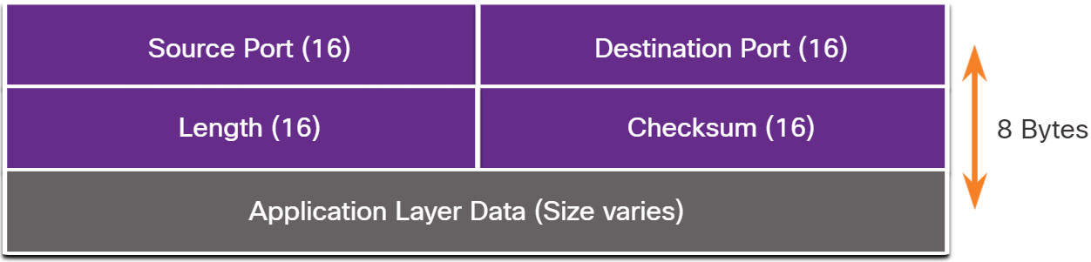
The Transport Layer UDP Header
UDP is a stateless protocol meaning neither the client, nor the server, tracks the state of the communication session. If reliability is required when using UDP as the transport protocol, it must be handled by the application.
The requirements for delivering live video and voice over the network is the data continues to flow quickly. Live video and voice applications can tolerate some data loss and are perfectly suited to UDP.
The blocks of communication in UDP are called datagrams, or segments. These datagrams are sent as best effort by the transport layer protocol.
The UDP header is only has four fields and requires 8 bytes (64 bits). The figure shows the fields in a UDP header.
Notes:
9 – The Transport Layer
9.1 – Transport Layer Characteristics
9.1.8 – UDP Header

Slide 25
The Transport Layer UDP Header Fields
The table identifies and describes the four fields in a UDP header.
UDP Header Field | Description
Source Port | A 16-bit field used to identify the source application by port number.
Destination Port | A 16-bit field used to identify the destination application by port number.
Sequence Number | A 32-bit field used for data reassembly purposes.
Length | A 16-bit field that indicates the length of the UDP datagram header.
Checksum | A 16-bit field used for error checking of the datagram header and data.
Notes:
9 – The Transport Layer
9.1 – Transport Layer Characteristics
9.1.9 – UDP Header Fields

Slide 26
The Transport Layer Socket Pairs
The source and destination ports are placed within the segment. The segments are then encapsulated within an IP packet.
The IP packet contains the IP address of the source and destination. The combination of the source IP address and source port number, or the destination IP address and destination port number is known as a socket.
Sockets enable multiple processes, running on a client, to distinguish themselves from each other, and multiple connections to a server process to be distinguished from each other.
The source port number acts as a return address for the requesting application.
The transport layer keeps track of this port and the application that initiated the request so that when a response is returned, it can be forwarded to the correct application.
Notes:
9 – The Transport Layer
9.1 – Transport Layer Characteristics
9.1.10 – Socket Pair

Slide 27
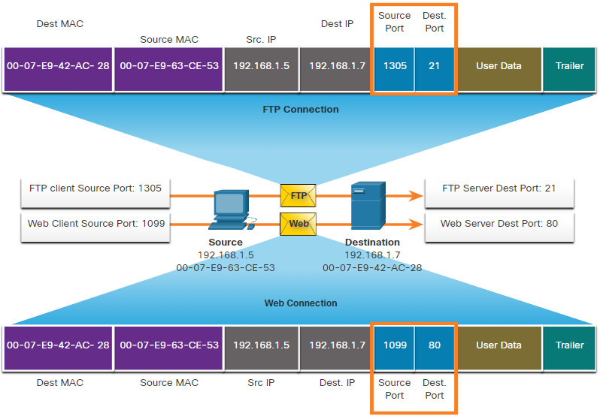
The Transport Layer Socket Pairs (Contd.)
In the figure, the PC is simultaneously requesting FTP and web services from the destination server.
The FTP request generated by the PC includes the Layer 2 MAC addresses and the Layer 3 IP addresses. The request also identifies the source port number 1305 and destination port, identifying the FTP services on port 21.
The host also has requested a web page from the server using the same Layer 2 and Layer 3 addresses.
Notes:
9 – The Transport Layer
9.1 – Transport Layer Characteristics
9.1.10 – Socket Pair

Slide 28
The Transport Layer Socket Pairs (Contd.)
It is using the source port number 1099 and destination port identifying the web service on port 80.
The socket is used to identify the server and service being requested by the client.
A client socket with 1099 representing the source port number might be 192.168.1.5:1099. The socket on a web server might be 192.168.1.7:80. Together, these two sockets combine to form a socket pair: 192.168.1.5:1099, 192.168.1.7:80
Notes:
9 – The Transport Layer
9.1 – Transport Layer Characteristics
9.1.10 – Socket Pair
9.1.11 – Check Your Understanding – Compare TCP and UDP Characteristics

Slide 29
9.2 Transport Layer Session Establishment
Notes:
Source:
9 – The Transport Layer
9.2 – Transport Layer Session Establishment
In-Session Activities / Explanations:
Time: 20 min
Instructor Notes:
Introduce the topic and discuss the transport layer session establishment.
Explain the TCP server processes.
Describe the processes of TCP connection establishment and session termination.
Explain the TCP three-way handshake analysis.
By the end of the topic, encourage the learners to perform the given hands-on lab and activity.
Key Points: TCP Sever process, TCP Connection establishment, Session termination, TCP Three-way Handshake Analysis

Slide 30
Transport Layer Session Establishment TCP Server Processes
Each application process running on a server is configured to use a port number. The port number is either automatically assigned or configured manually by a system administrator.
An individual server cannot have two services assigned to the same port number within the same transport layer services.
A host running a web server application and a file transfer application cannot have both configured to use the same port, such as TCP port 80.
An active server application assigned to a specific port is considered open, which means that the transport layer accepts, and processes segments addressed to that port.
Any incoming client request addressed to the correct socket is accepted, and the data is passed to the server application.
There can be many ports open simultaneously on a server, one for each active server application.
Notes:
9 – The Transport Layer
9.2 – Transport Layer Session Establishment
9.2.1 – TCP Server Processes

Slide 31
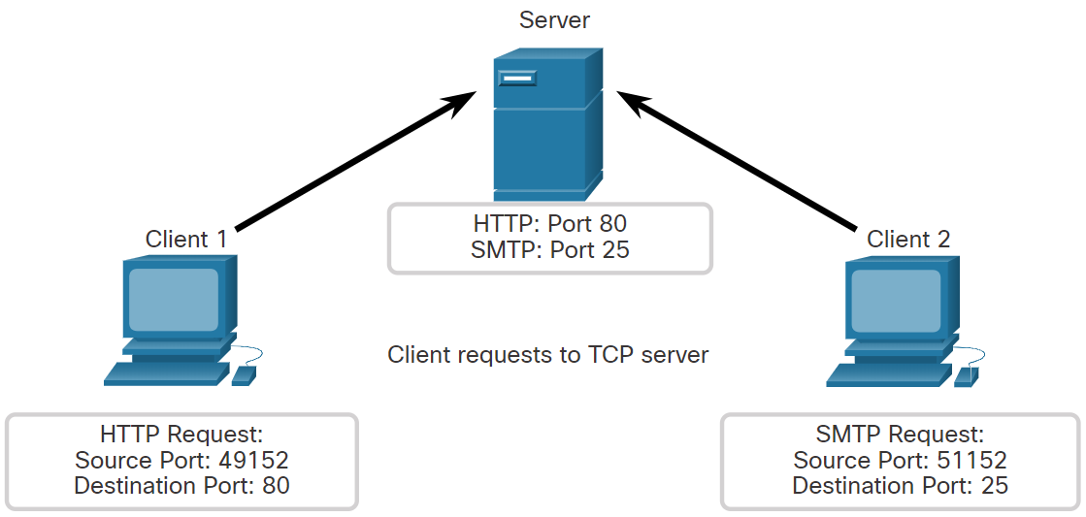
Transport Layer Session Establishment TCP Server Processes (Contd.)
Clients Sending TCP Requests
Client 1 is requesting web services and Client 2 is requesting email service of the same sever.
Notes:
9 – The Transport Layer
9.2 – Transport Layer Session Establishment
9.2.1 – TCP Server Processes

Slide 32
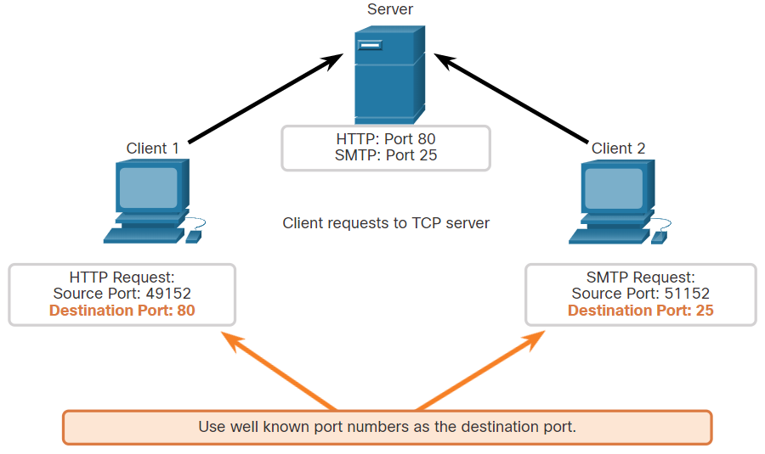
Transport Layer Session Establishment TCP Server Processes (Contd.)
Request Destination Ports
Client 1 is requesting web services using well-known destination port 80 (HTTP) and Client 2 is requesting email service using well-known port 25 (SMTP).
Notes:
9 – The Transport Layer
9.2 – Transport Layer Session Establishment
9.2.1 – TCP Server Processes

Slide 33
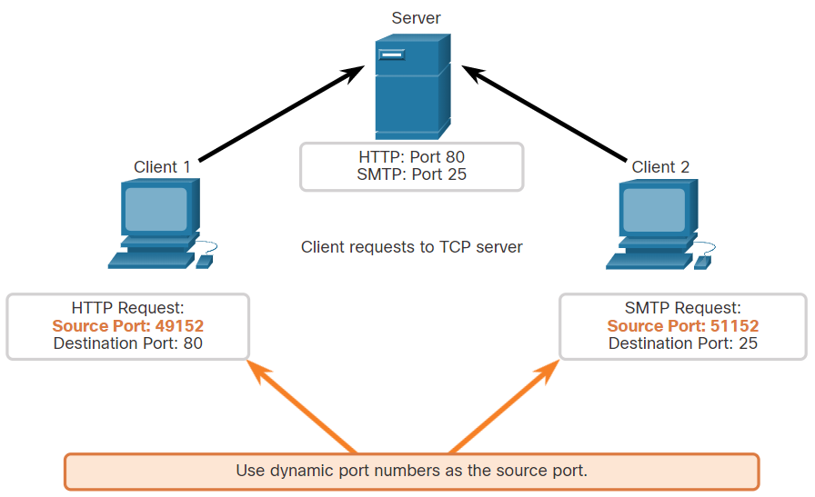
Transport Layer Session Establishment TCP Server Processes (Contd.)
Request Source Ports
Client requests dynamically generate a source port number. In this case, Client 1 is using source port 49152 and Client 2 is using source port 51152.
Notes:
9 – The Transport Layer
9.2 – Transport Layer Session Establishment
9.2.1 – TCP Server Processes

Slide 34
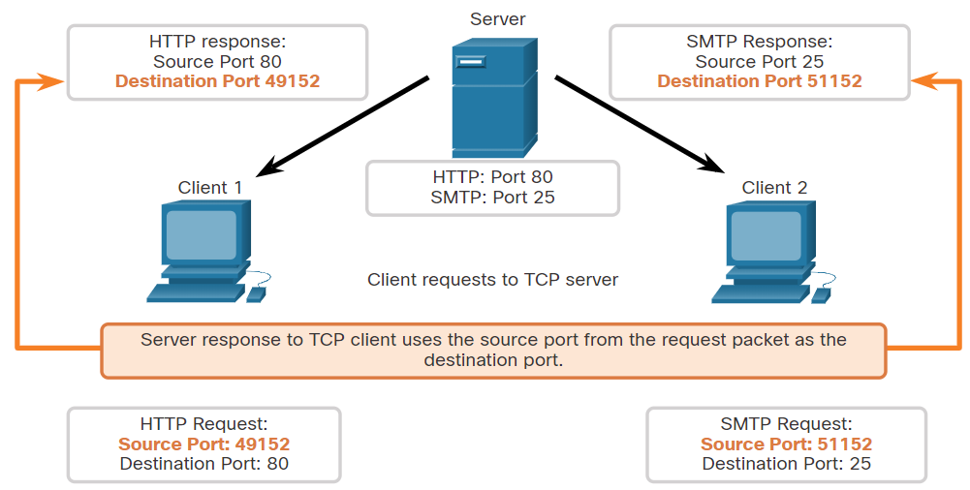
Transport Layer Session Establishment TCP Server Processes (Contd.)
Response Destination Ports
When the server responds to the client requests, it reverses the destination and source ports of the initial request. Notice that the Server response to the web request now has destination port 49152 and the email response now has destination port 51152.
Notes:
9 – The Transport Layer
9.2 – Transport Layer Session Establishment
9.2.1 – TCP Server Processes

Slide 35
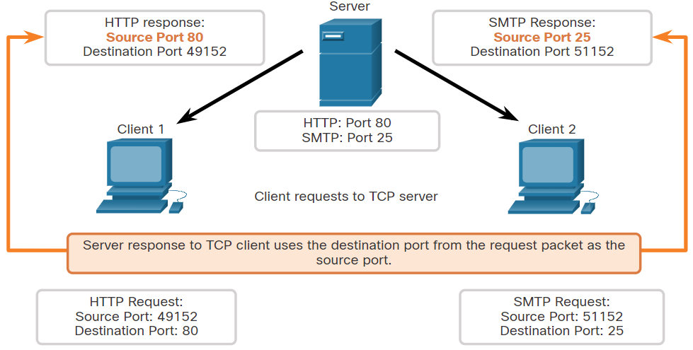
Transport Layer Session Establishment TCP Server Processes (Contd.)
Response Source Ports
The source port in the server response is the original destination port in the initial requests.
Notes:
9 – The Transport Layer
9.2 – Transport Layer Session Establishment
9.2.1 – TCP Server Processes

Slide 36
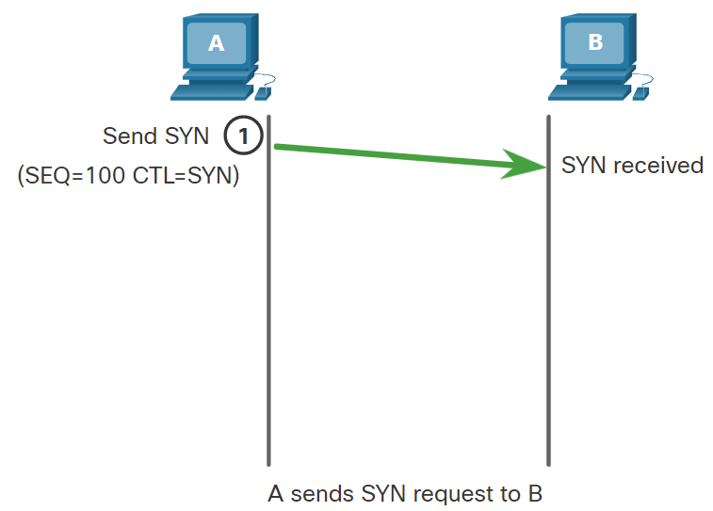
Transport Layer Session Establishment TCP Connection Establishment
In TCP connections, the host client establishes the connection with the server using the three-way handshake process.
The three-way handshake validates that the destination host is available to communicate.
The TCP connection establishment steps are:
Step 1. SYN: The initiating client requests a client-to-server communication session with the server.
Notes:
9 – The Transport Layer
9.2 – Transport Layer Session Establishment
9.2.2 – TCP Connection Establishment

Slide 37
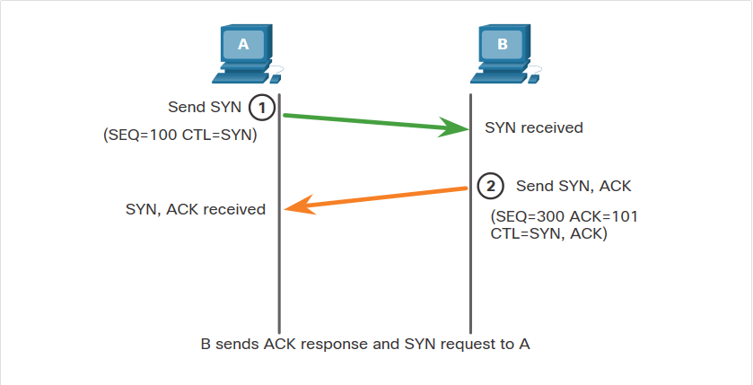
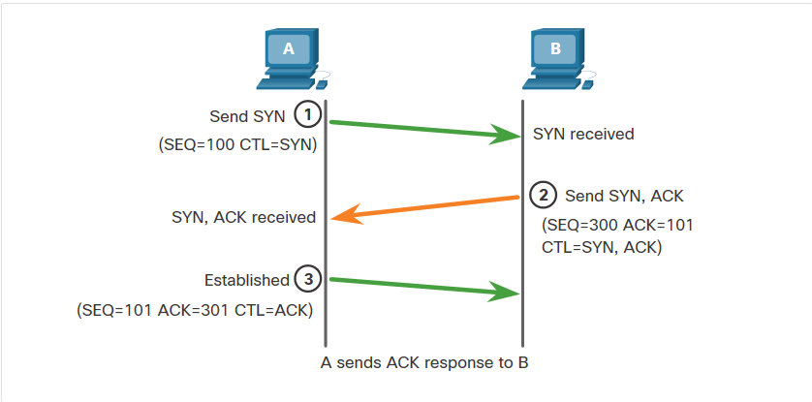
Transport Layer Session Establishment TCP Connection Establishment (Contd.)
Step 2. ACK and SYN: The server acknowledges the client-to-server communication session and requests a server-to-client communication session.
Step 3. ACK: The initiating client acknowledges the server-to-client communication session.
Notes:
9 – The Transport Layer
9.2 – Transport Layer Session Establishment
9.2.2 – TCP Connection Establishment

Slide 38
Transport Layer Session Establishment Session Termination
To close a connection, the Finish (FIN) control flag must be set in the segment header.
To end each one-way TCP session, a two-way handshake, consisting of a FIN segment and an Acknowledgment (ACK) segment, is used.
Therefore, to terminate a single conversation supported by TCP, four exchanges are needed to end both sessions. Either the client or the server can initiate the termination.
The terms client and server are used as a reference for simplicity, but any two hosts that have an open session can initiate the termination process.
When all segments have been acknowledged, the session is closed.
Notes:
9 – The Transport Layer
9.2 – Transport Layer Session Establishment
9.2.3 – Session Termination

Slide 39
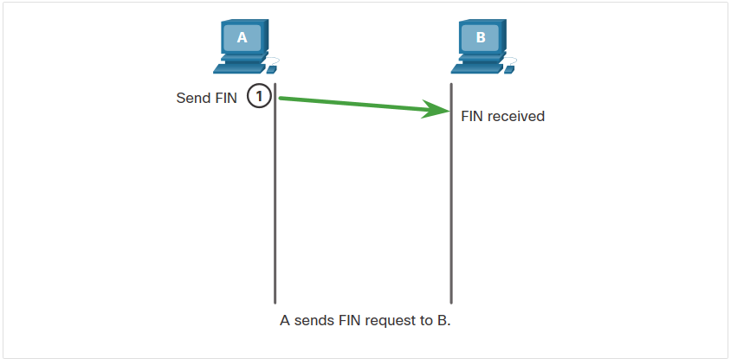
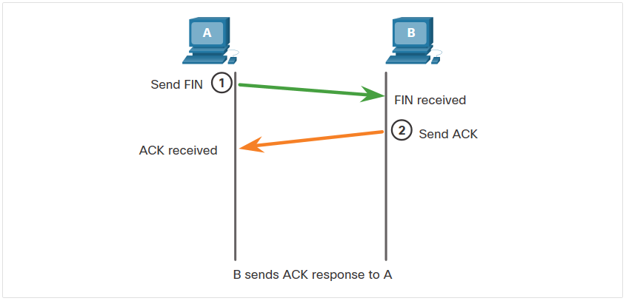
Transport Layer Session Establishment Session Termination (Contd.)
The session termination steps are:
Step 1. FIN: When the client has no more data to send in the stream, it sends a segment with the FIN flag set.
Step 2. ACK: The server sends an ACK to acknowledge the receipt of the FIN to terminate the session from client to server.
Notes:
9 – The Transport Layer
9.2 – Transport Layer Session Establishment
9.2.3 – Session Termination

Slide 40
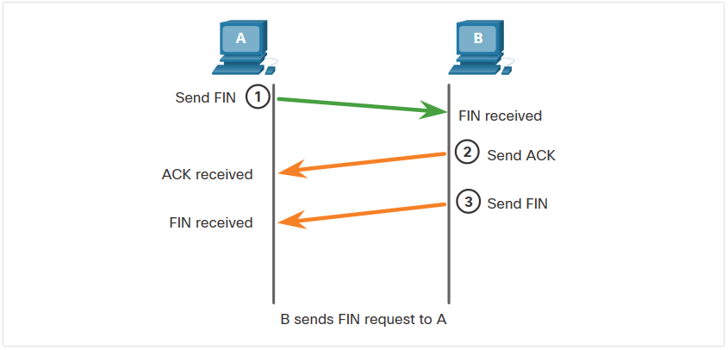
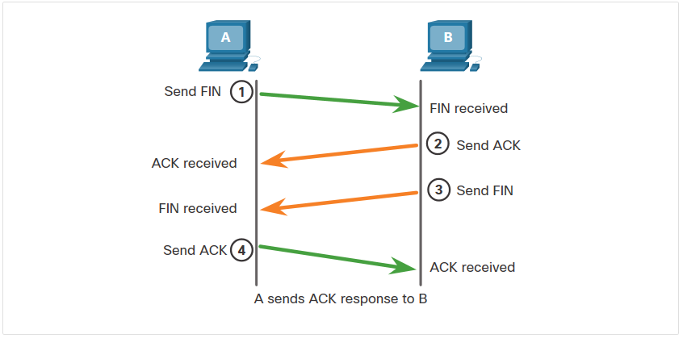
Transport Layer Session Establishment Session Termination (Contd.)
Step 3. FIN: The server sends a FIN to the client to terminate the server-to-client session.
Step 4. ACK: The client responds with an ACK to acknowledge the FIN from the server.
Notes:
9 – The Transport Layer
9.2 – Transport Layer Session Establishment
9.2.3 – Session Termination

Slide 41
Transport Layer Session Establishment TCP Three-way Handshake Analysis
Hosts maintain state, track each data segment within a session, and exchange information about the data is received using the information in the TCP header.
TCP is a full-duplex protocol, where each connection represents two one-way communication sessions. To establish the connection, the hosts perform a three-way handshake. As shown in the figure, control bits in the TCP header indicate the progress and status of the connection.
The functions of the three-way handshake are:
It establishes that the destination device is present on the network.
It verifies that the destination device has an active service and is accepting requests on the destination port number that the initiating client intends to use.
It informs the destination device that the source client intends to establish a communication session on that port number.
After the communication is completed the sessions are closed, and the connection is terminated. The connection and session mechanisms enable TCP reliability function.
Notes:
9 – The Transport Layer
9.2 – Transport Layer Session Establishment
9.2.4 – TCP Three-way Handshake Analysis

Slide 42
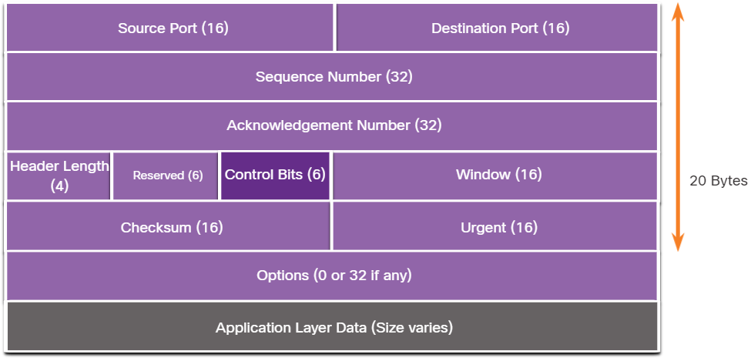
Transport Layer Session Establishment TCP Three-way Handshake Analysis (Contd.)
The six bits in the Control Bits field of the TCP segment header are also known as flags. A flag is a bit that is set to either on or off. The six control bits flags are as follows:
URG - Urgent pointer field significant
ACK - Acknowledgment flag used in connection establishment and session termination
PSH - Push function
RST - Reset the connection when an error or timeout occurs
SYN - Synchronize sequence numbers used in connection establishment
FIN - No more data from sender and used in session termination
Notes:
9 – The Transport Layer
9.2 – Transport Layer Session Establishment
9.2.4 – TCP Three-way Handshake Analysis

Slide 43
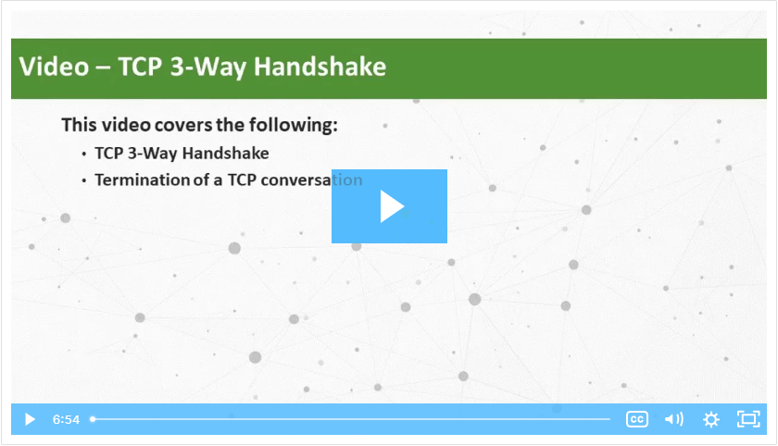
Transport Layer Session Establishment Video – TCP 3-Way Handshake
Watch the video to learn more of the TCP 3-way handshake.
Notes:
9 – The Transport Layer
9.2 – Transport Layer Session Establishment
9.2.5 – Video – TCP 3-Way Handshake

Slide 44
Transport Layer Session Establishment Lab – Using Wireshark to Observe the TCP 3-Way Handshake
In this lab, you will complete the following objectives:
Part 1: Prepare the Hosts to Capture the Traffic
Part 2: Analyze the Packets using Wireshark
Part 3: View the Packets using tcpdump
Notes:
9 – The Transport Layer
9.2 – Transport Layer Session Establishment
9.2.6 – Lab – Using Wireshark to Observe the TCP 3-Way Handshake
9.2.7 – Check Your Understanding – TCP Connection and Termination Process

Slide 45
9.3 Transport Layer Reliability
Notes:
Source:
9 – The Transport Layer
9.3 – Transport Layer Reliability
In-Session Activities / Explanations:
Time: 25 min
Instructor Notes:
Give a brief introduction to the topic and discuss the transport layer reliability.
Describe the various features of TCP.
By the end of the topic, encourage the learners to perform the given hands-on lab and activity.
Key Points: TCP reliability, Retransmission, congestion avoidance.

Slide 46
Transport Layer Reliability TCP Reliability - Guaranteed and Ordered Delivery
There may be times when either TCP segments do not arrive at their destination or arrive out of order.
For the original message to be understood by the recipient, all the data must be received and the data in these segments must be reassembled into the original order.
Sequence numbers are assigned in the header for each packet to achieve this goal. The sequence number represents the first data byte of the TCP segment.
During session setup, an initial sequence number (ISN) is set, which represents the starting value of the bytes that are transmitted to the receiving application.
As data is transmitted during the session, the sequence number is incremented by the number of bytes that have been transmitted.
This data byte tracking enables each segment to be uniquely identified and acknowledged. Missing segments can then be identified.
The ISN is effectively a random number which prevents certain types of malicious attacks.
Notes:
9 – The Transport Layer
9.3 – Transport Layer Reliability
9.3.1 – TCP Reliability - Guaranteed and Ordered Delivery

Slide 47
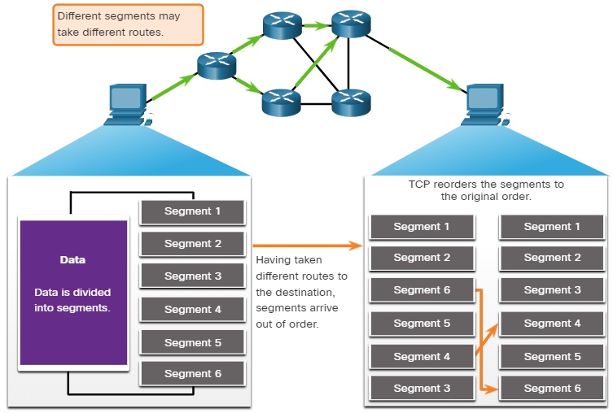
Transport Layer Reliability TCP Reliability - Guaranteed and Ordered Delivery (Contd.)
Segment sequence numbers indicate how to reassemble and reorder received segments, as shown in the figure.
The receiving TCP process places the data from a segment into a receiving buffer.
Segments are then placed in the proper sequence order and passed to the application layer when reassembled.
Any segments that arrive with sequence numbers that are out of order are held for later processing.
Then, when the segments with the missing bytes arrives, these segments are processed in order.
Notes:
9 – The Transport Layer
9.3 – Transport Layer Reliability
9.3.1 – TCP Reliability - Guaranteed and Ordered Delivery

Slide 48
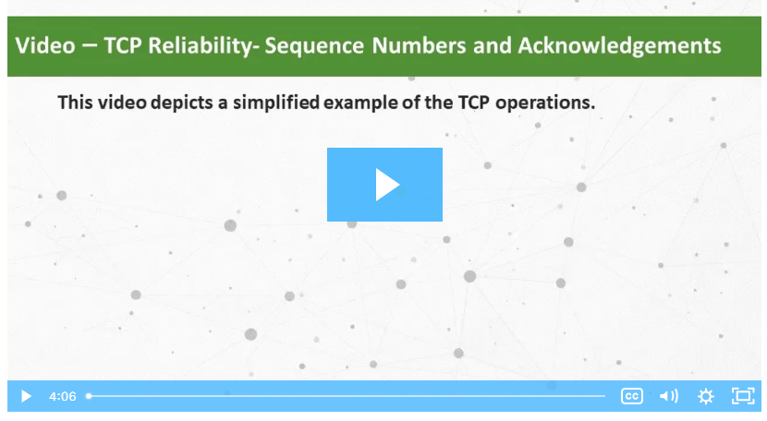
Transport Layer Reliability Video - TCP Reliability – Sequence Numbers and Acknowledgements
One of the functions of TCP is to ensure that each segment reaches its destination. The TCP services on the destination host acknowledge the data that have been received by the source application.
Click Play in the figure to view a lesson on TCP sequence numbers and acknowledgments.
Notes:
9 – The Transport Layer
9.3 – Transport Layer Reliability
9.3.2 – Video - TCP Reliability – Sequence Numbers and Acknowledgements

Slide 49
Transport Layer Reliability TCP Reliability - Data Loss and Retransmission
TCP provides methods of managing the segment losses by retransmitting the segments for unacknowledged data.
The sequence (SEQ) number and acknowledgement (ACK) number are used together to confirm receipt of the bytes of data contained in the transmitted segments.
The SEQ number identifies the first byte of data in the segment being transmitted.
TCP uses the ACK number sent back to the source to indicate the next byte that the receiver expects to receive. This is called expectational acknowledgement.
Prior to later enhancements, TCP could only acknowledge the next byte expected.
Notes:
9 – The Transport Layer
9.3 – Transport Layer Reliability
9.3.3 – TCP Reliability - Data Loss and Retransmission

Slide 50
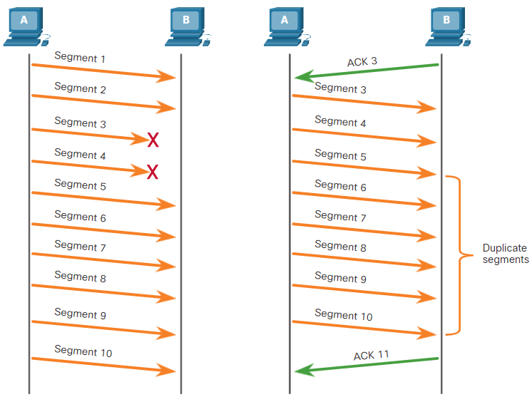
Transport Layer Reliability TCP Reliability - Data Loss and Retransmission (Contd.)
In the figure, Host A sends segments 1 through 10 to host B. If all the segments arrive except segments 3 and 4, host B would reply with acknowledgment specifying that the next segment expected is segment 3.
Host A has no idea if any other segments arrived or not. It would resend segments 3 through 10.
If all the resent segments arrived successfully, segments 5 through 10 would be duplicates. This can lead to delays, congestion, and inefficiencies.
Notes:
9 – The Transport Layer
9.3 – Transport Layer Reliability
9.3.3 – TCP Reliability - Data Loss and Retransmission

Slide 51
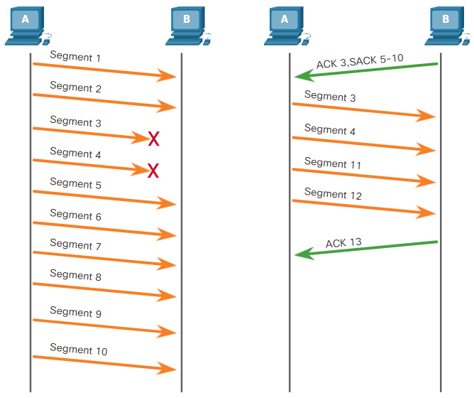
Transport Layer Reliability TCP Reliability - Data Loss and Retransmission (Contd.)
Host operating systems employ an optional TCP feature called selective acknowledgment (SACK), negotiated during the three-way handshake.
If both hosts support SACK, the receiver can acknowledge which segments (bytes) were received including any discontinuous segments.
The sending host would only need to retransmit the missing data.
In the figure, host A sends segments 1 through 10 to host B.
If all the segments arrive except for segments 3 and 4, host B can acknowledge that it has received segments 1 and 2 (ACK 3), and selectively acknowledge segments 5 through 10 (SACK 5-10). Host A would only need to resend segments 3 and 4.
Notes:
9 – The Transport Layer
9.3 – Transport Layer Reliability
9.3.3 – TCP Reliability - Data Loss and Retransmission

Slide 52
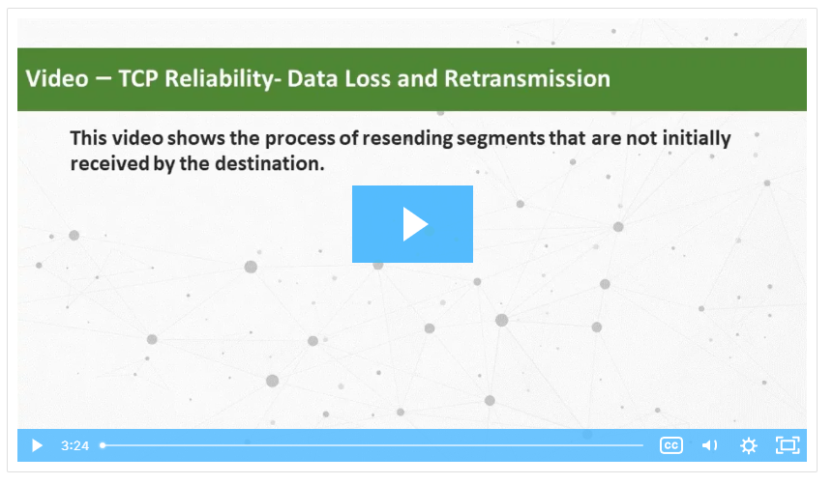
Transport Layer Reliability Video - TCP Reliability - Data Loss and Retransmission
Click Play in the figure to view a lesson on TCP retransmission.
Notes:
9 – The Transport Layer
9.3 – Transport Layer Reliability
9.3.4 – Video - TCP Reliability - Data Loss and Retransmission

Slide 53
Transport Layer Reliability TCP Flow Control - Window Size and Acknowledgments
TCP also provides mechanisms for flow control. Flow control is the amount of data that the destination can receive and process reliably.
Flow control helps maintain the reliability of TCP transmission by adjusting the rate of data flow between source and destination for a given session.
To accomplish this, the TCP header includes a 16-bit field called the window size.
The window size that determines the number of bytes that can be sent before expecting an acknowledgment.
The acknowledgment number is the number of the next expected byte.
The window size is the number of bytes that the destination device of a TCP session can accept and process at one time.
Notes:
9 – The Transport Layer
9.3 – Transport Layer Reliability
9.3.5 – TCP Flow Control - Window Size and Acknowledgments

Slide 54
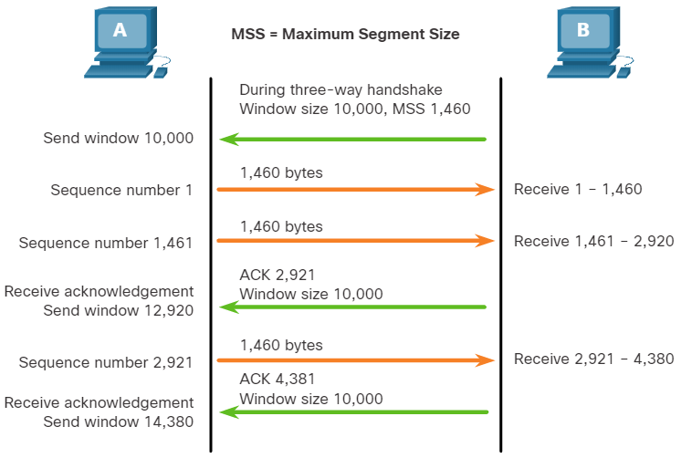
Transport Layer Reliability TCP Flow Control - Window Size and Acknowledgments (Contd.)
The figure shows an example of window size and acknowledgments.
The window size is included in every TCP segment so the destination can modify the window size at any time depending on buffer availability.
The initial window size is agreed upon when the TCP session is established during the three-way handshake.
The source device must limit the number of bytes sent to the destination device based on the window size of the destination. Only after the source receives an acknowledgment, it can continue sending more data for the session.
Notes:
9 – The Transport Layer
9.3 – Transport Layer Reliability
9.3.5 – TCP Flow Control - Window Size and Acknowledgments

Slide 55
Transport Layer Reliability TCP Flow Control - Window Size and Acknowledgments (Contd.)
The destination will not wait for all the bytes for its window size to be received before replying with an acknowledgment.
As the bytes are received and processed, the destination will send acknowledgments to inform the source that it can continue to send additional bytes.
A destination sending acknowledgments as it processes bytes received, and the continual adjustment of the source send window, is known as sliding windows.
If the availability of the destination’s buffer space decreases, it may reduce its window size to inform the source to reduce the number of bytes it should send without receiving an acknowledgment.
Note: Devices today use the sliding windows protocol. The receiver sends an acknowledgment after every two segments it receives. The advantage of sliding windows is that it allows the sender to continuously transmit segments, as long as the receiver is acknowledging previous segments.
Notes:
9 – The Transport Layer
9.3 – Transport Layer Reliability
9.3.5 – TCP Flow Control - Window Size and Acknowledgments

Slide 56
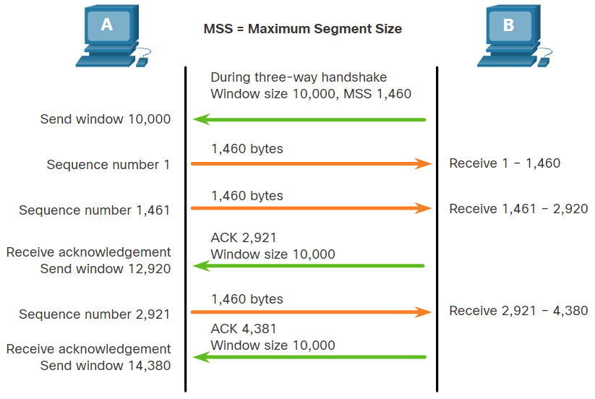
Transport Layer Reliability TCP Flow Control - Maximum Segment Size (MSS)
In the figure, the source is transmitting 1,460 bytes of data within each TCP segment. This is the Maximum Segment Size (MSS) that the destination device can receive.
The MSS is part of the options field in the TCP header that specifies the largest amount of data, in bytes, that a device can receive in a single TCP segment.
The MSS size does not include the TCP header.
The MSS is included during the three-way handshake.
Notes:
9 – The Transport Layer
9.3 – Transport Layer Reliability
9.3.6 – TCP Flow Control - Maximum Segment Size (MSS)

Slide 57
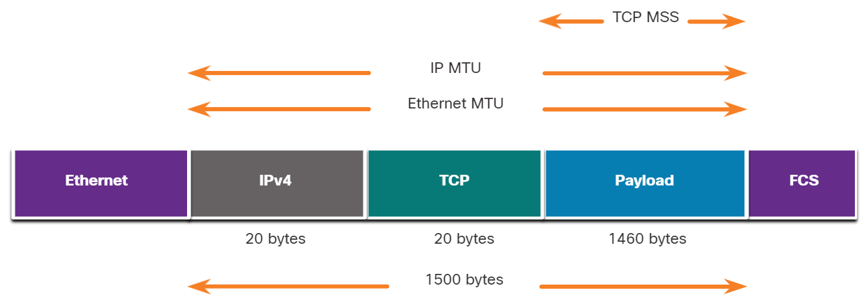
Transport Layer Reliability TCP Flow Control - Maximum Segment Size (MSS) (Contd.)
A common MSS is 1,460 bytes when using IPv4. A host determines the value of its MSS field by subtracting the IP and TCP headers from the Ethernet maximum transmission unit (MTU).
On an Ethernet interface, the default MTU is 1500 bytes. Subtracting the IPv4 header of 20 bytes and the TCP header of 20 bytes, the default MSS size will be 1460 bytes, as shown in the figure.
Notes:
9 – The Transport Layer
9.3 – Transport Layer Reliability
9.3.6 – TCP Flow Control - Maximum Segment Size (MSS)

Slide 58
Transport Layer Reliability TCP Flow Control - Congestion Avoidance
When congestion occurs on a network, it results in packets being discarded by the overloaded router.
When packets containing TCP segments do not reach their destination, they are left unacknowledged.
By determining the rate at which TCP segments are sent but not acknowledged, the source can assume a certain level of network congestion.
Whenever there is congestion, retransmission of lost TCP segments from the source will occur.
If the retransmission is not properly controlled, the additional retransmission of the TCP segments can make the congestion even worse.
Not only are new packets with TCP segments introduced into the network, but the feedback effect of the retransmitted TCP segments that were lost will also add to the congestion.
To avoid and control congestion, TCP employs several congestion handling mechanisms, timers, and algorithms.
Notes:
9 – The Transport Layer
9.3 – Transport Layer Reliability
9.3.7 – TCP Flow Control - Congestion Avoidance

Slide 59
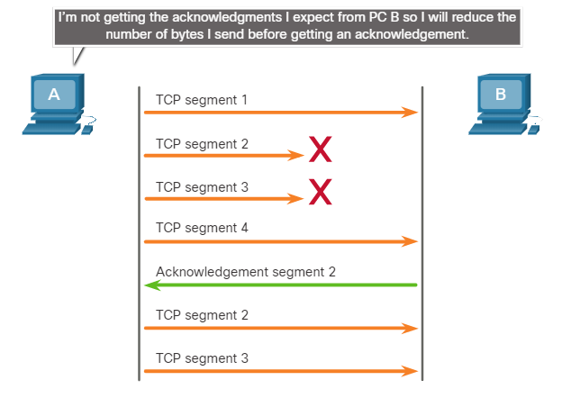
Transport Layer Reliability TCP Flow Control - Congestion Avoidance (Contd.)
If the source determines that the TCP segments are either not being acknowledged or not acknowledged in a timely manner, then it can reduce the number of bytes it sends before receiving an acknowledgment.
As shown in the figure, PC A senses there is congestion and therefore, reduces the number of bytes it sends before receiving an acknowledgment from PC B.
Acknowledgment numbers are for the next expected byte and not for a segment. The segment numbers used are simplified for illustration purposes.
Notes:
9 – The Transport Layer
9.3 – Transport Layer Reliability
9.3.7 – TCP Flow Control - Congestion Avoidance

Slide 60
Transport Layer Reliability Lab – Exploring Nmap
Port scanning is usually part of a reconnaissance attack.
There are a variety of port scanning methods that can be used.
We will explore how to use the Nmap utility. Nmap is a powerful network utility that is used for network discovery and security auditing.
Notes:
9 – The Transport Layer
9.3 – Transport Layer Reliability
9.3.8 – Lab – Exploring Nmap
9.3.9 – Check Your Understanding - Reliability and Flow Control

Slide 61
9.4 The Transport Layer Summary
Notes:
Source:
9 – The Transport Layer
9.4 – The Transport Layer Summary
In-Session Activities / Explanations:
Time: 5 min
Instructor Notes:
Read out the summary points mentioned on the slide.
Discuss the same with the participants.
Ask if they have any questions or doubts.
Help them finish the module quiz.
Key Points: NA

Slide 62
The Transport Layer Summary What Did I Learn in this Module?
The transport layer is the link between the application layer and the lower layers of the OSI model that are responsible for network transmission.
The transport layer includes TCP and UDP. Transport layer protocols specify how to transfer messages between hosts and is responsible for managing reliability requirements of a conversation.
The transport layer is responsible for tracking conversations (sessions), segmenting data and reassembling segments, adding segment header information, identifying applications, and conversation multiplexing.
TCP is stateful and reliable. It acknowledges data, resends lost data, and delivers data in sequenced order. TCP is used for email and the web.
UDP is stateless and fast. It has low overhead, does not requires acknowledgments, does not resend lost data, and processes data in the order in which it arrives. UDP is used for VoIP and DNS.
Notes:
9 – The Transport Layer
9.4 – The Transport Layer Summary
9.4.1 – What Did I Learn in this Module?

Slide 63
The Transport Layer Summary What Did I Learn in this Module? (Contd.)
The TCP and UDP transport layer protocols use port numbers to manage multiple simultaneous conversations. This is why the TCP and UDP header fields identify a source and destination application port number.
The three-way handshake establishes that the destination device is present on the network. It verifies that the destination device has an active service that is accepting requests on the destination port number that the initiating client intends to use.
The six control bits flags are: URG, ACK, PSH, RST, SYN, and FIN and are used to identify the function of TCP messages that are sent.
For the original message to be understood by the recipient, all the data must be received and the data in these segments must be reassembled into the original order.
Host operating systems today typically employ an optional TCP feature called selective acknowledgment (SACK), which is negotiated during the three-way handshake.
Flow control helps maintain the reliability of TCP transmission by adjusting the rate of data flow between source and destination.
Notes:
9 – The Transport Layer
9.4 – The Transport Layer Summary
9.4.1 – What Did I Learn in this Module?
9.4.2 – Module 9: The Transport Layer Quiz

Slide 64
Module 9 New Terms and Commands
Transmission Control Protocol (TCP) User Datagram Protocol (UDP) Socket Pairs Initial Sequence Number (ISN) | URG, ACK, PSH, RST, SYN, FIN Selective Acknowledgment (SACK) Maximum Segment Size (MSS) Ethernet Maximum Transmission Unit (MTU)
Notes:
9 – The Transport Layer
New Terms and Commands

